Slide 1
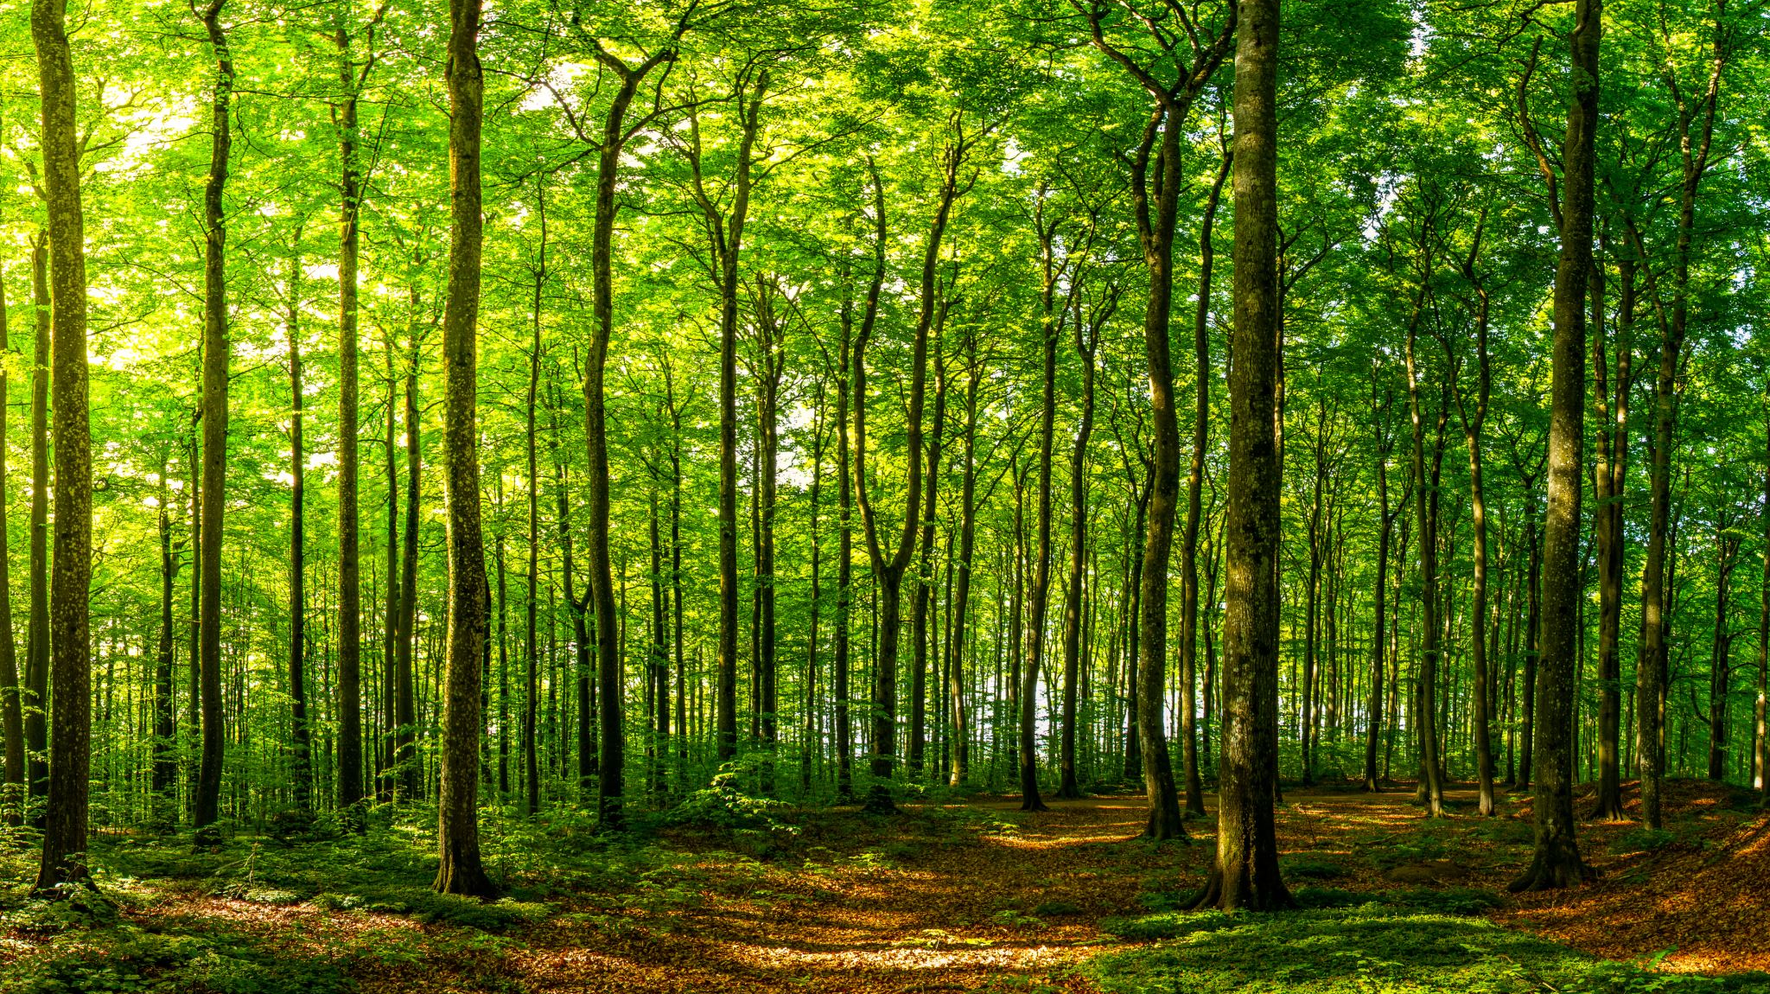
Deciduous Forest
Evan Steelhammer 2nd period

Slide 2

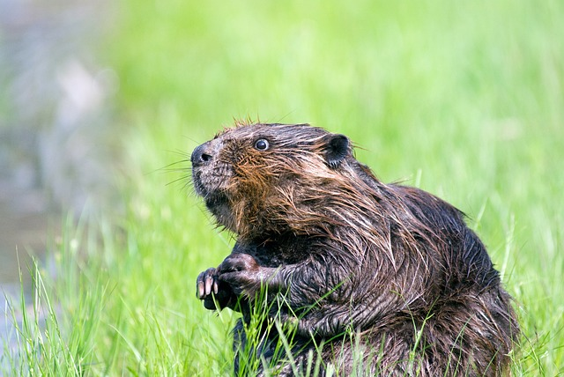
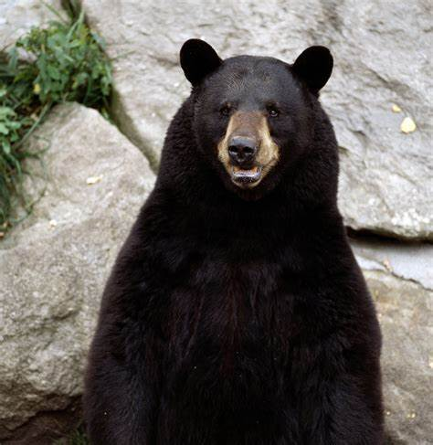
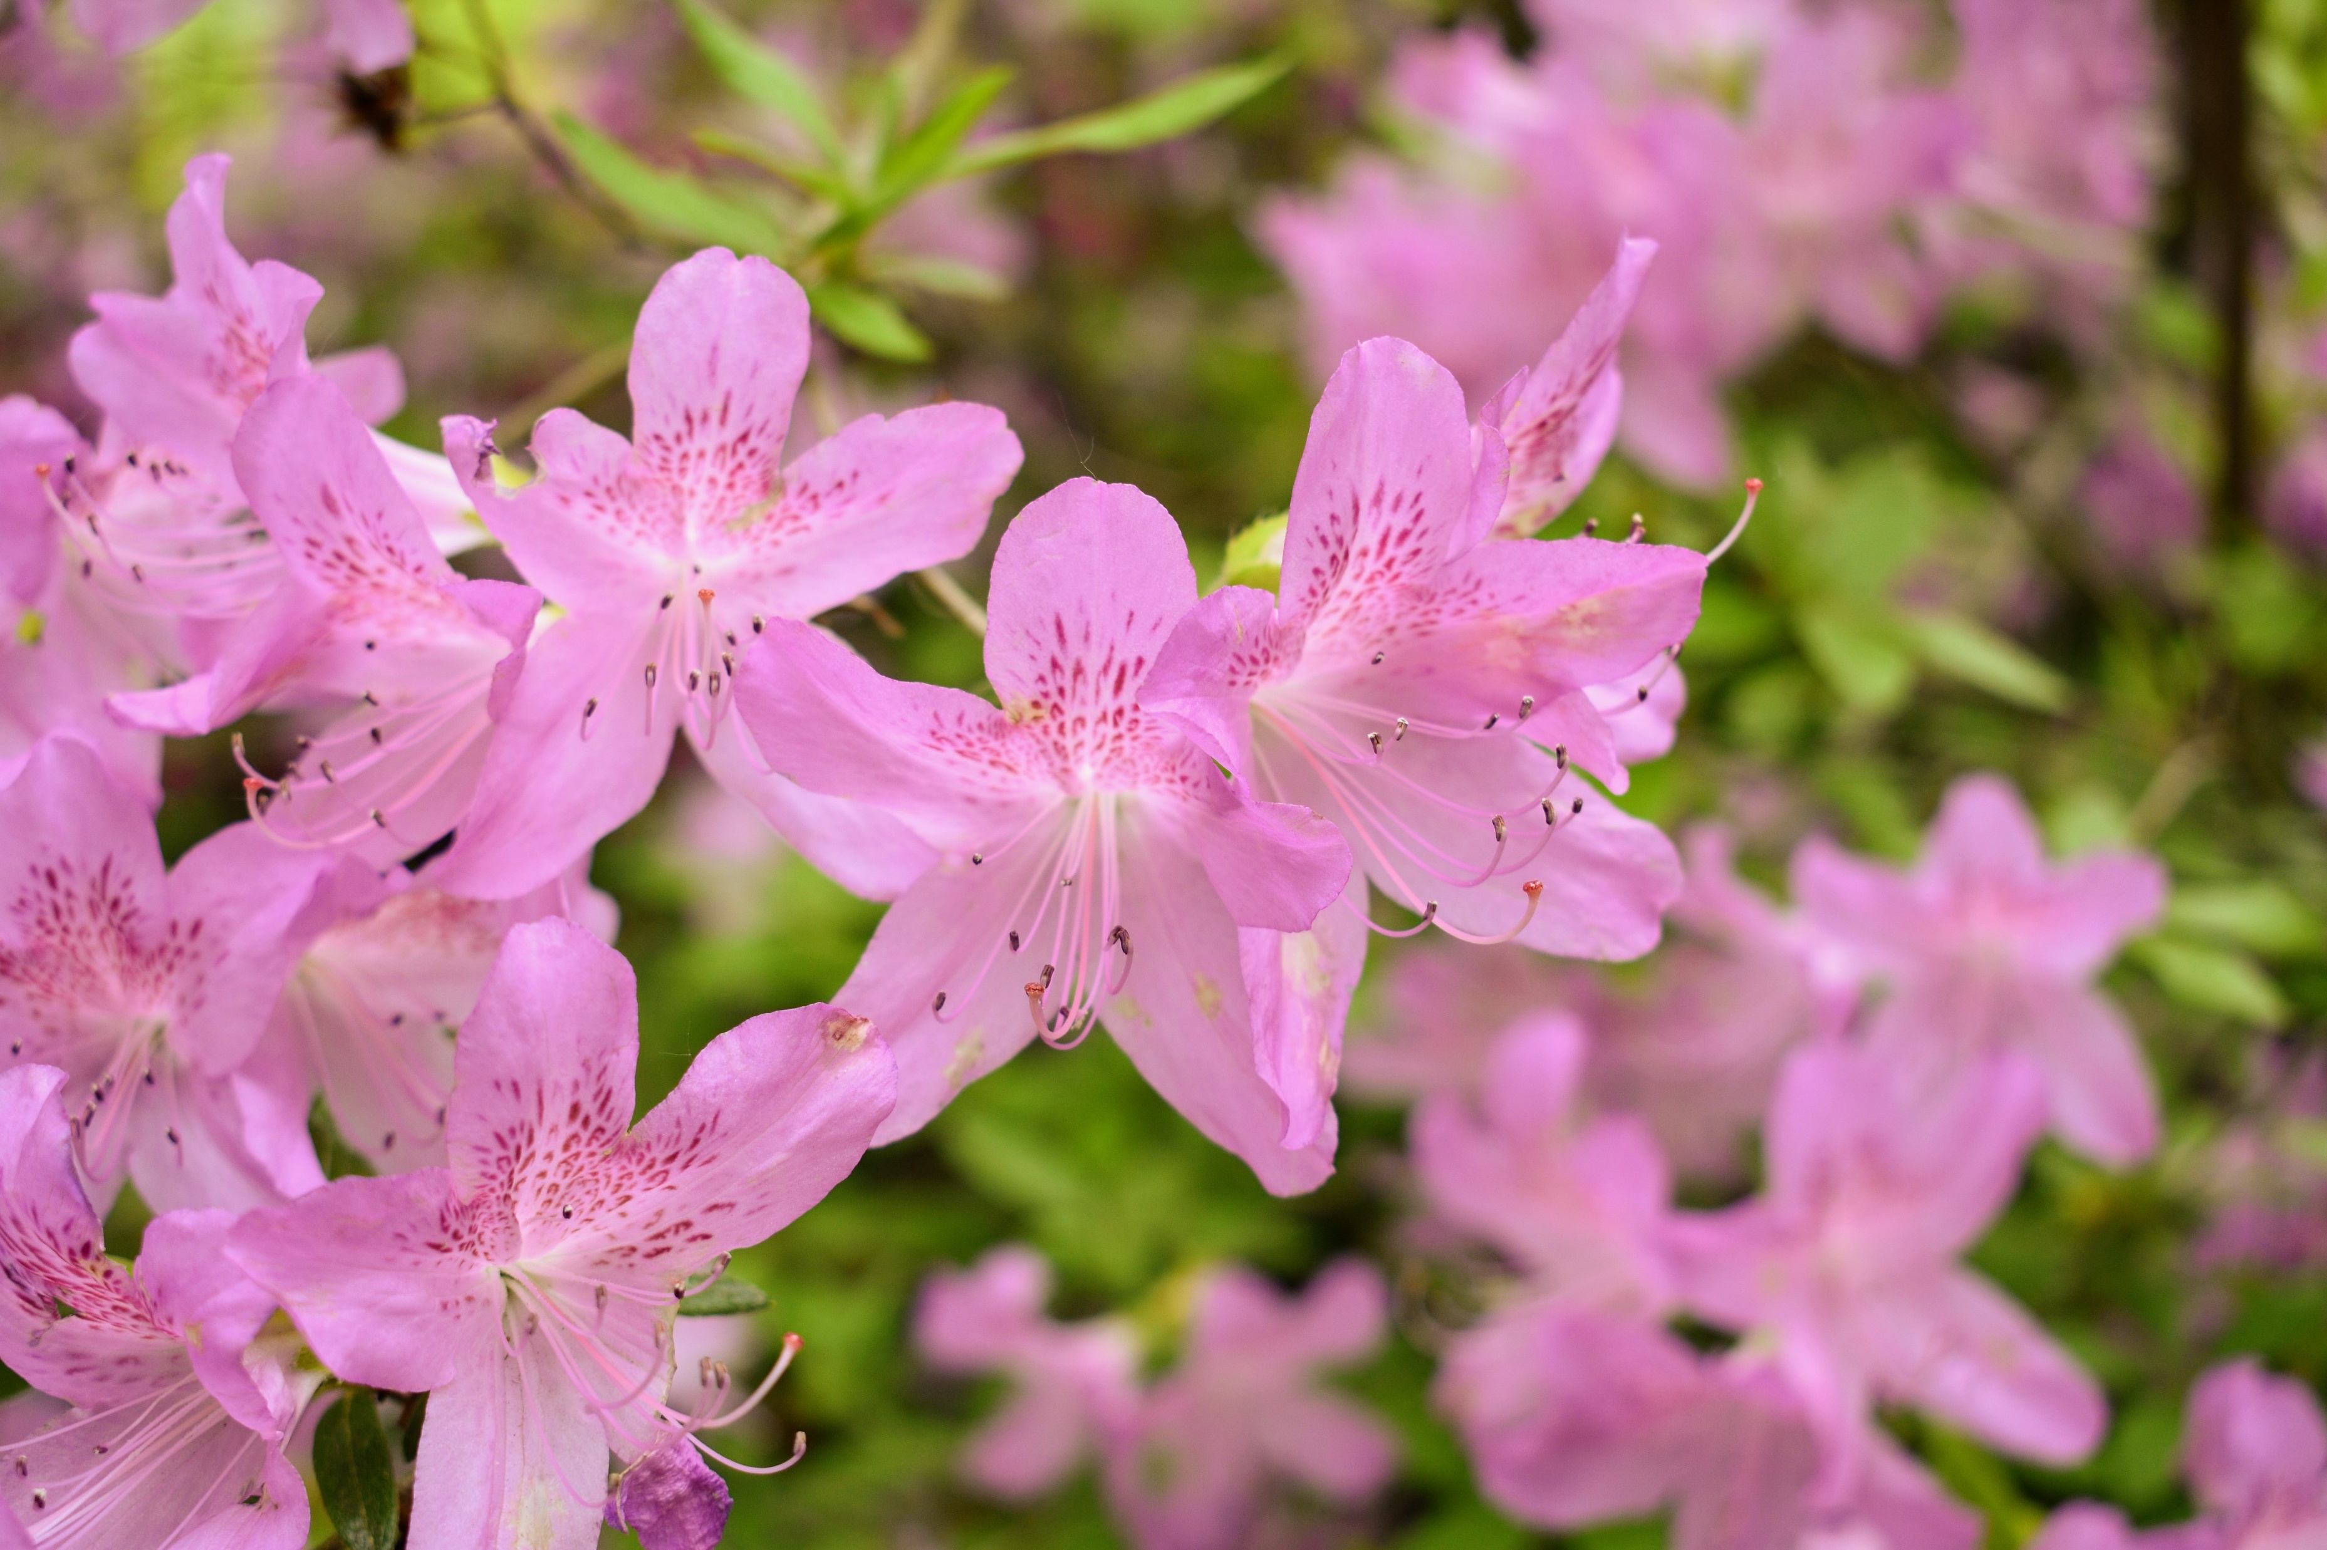
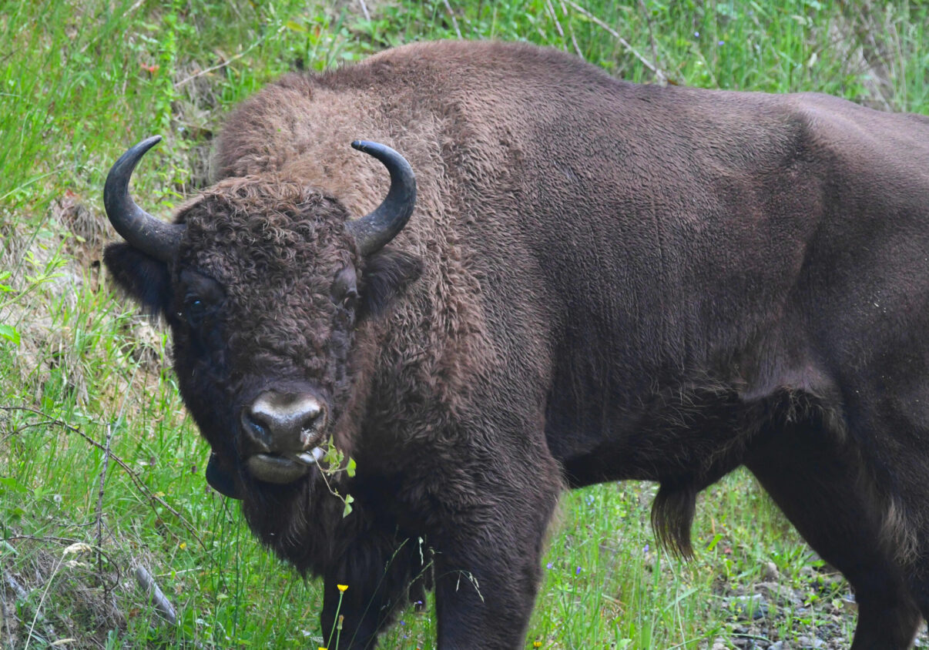
Info
Temp 70F in the summers below freezing in the winters
30 to 59 inches of rain annually
Fauna included
Black bear, beaver, bison, and deer
Flora consists of
Oak, beeches, birches, mountain laurel, and Azaleas

Slide 3
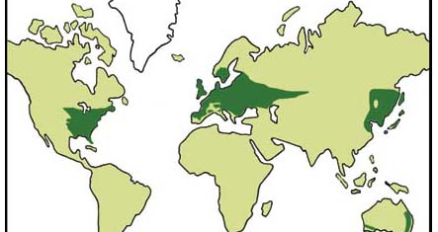
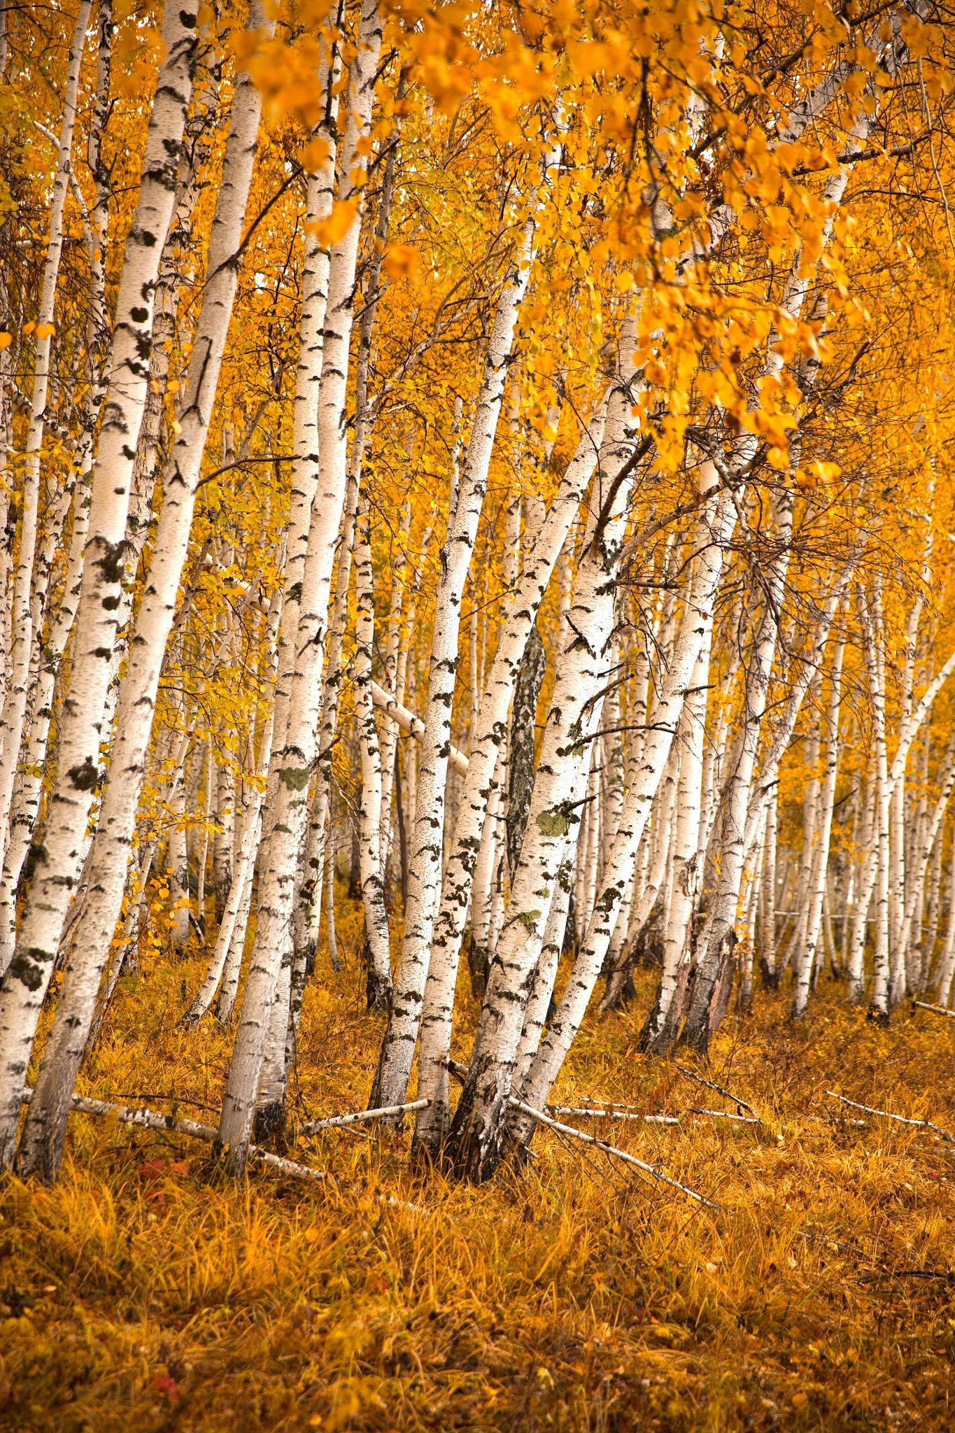
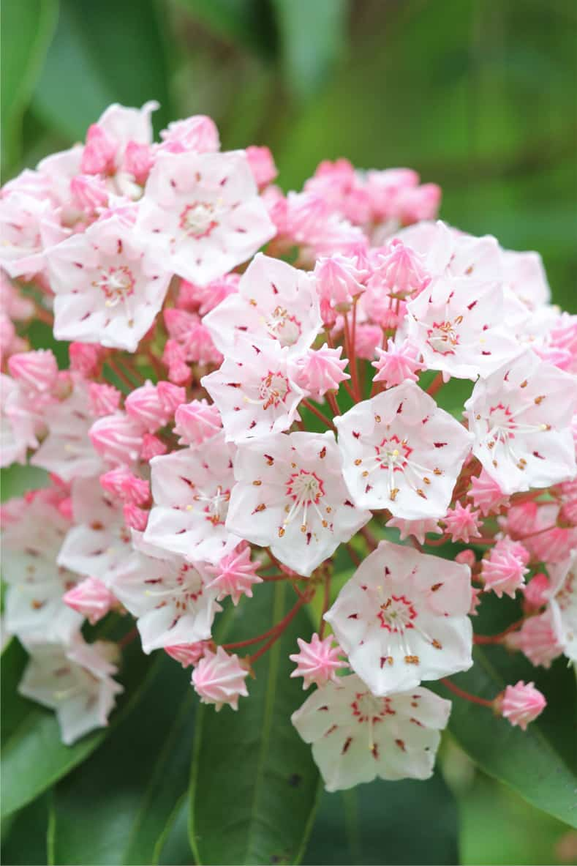

Slide 4

Deciduous forest are in
North America: Notably in the eastern half, including the Great Smoky Mountains National Park in the United States.
Europe: Parts of central and western Europe, with famous forests like the European Temperate Deciduous Forest.
Asia: Including the Northeast China Plain, parts of Russia, Japan, and China.
Southern Hemisphere: In the southernmost part of South America and New Zealand.

Slide 5
Producer - Azaleas
producer: an organism that synthesizes its own food from inorganic substances using light or chemical energy.
Sun Tolerance: can handle more sun if they receive sufficient water.
Water Tolerance: Some species, like the swamp Azalea, can be planted in moist to wet areas and tolerate extreme cold well.

Slide 6
Primary consumer - Beaver
primary consumer: an organism that feeds on primary producers, such as Azaleas
Description: Beavers are large, semi-aquatic rodents known for their flat, scaly tails and their ability to build dams and lodges
Adaptation: continuously growing, chisel-like teeth, which allow it to gnaw through wood

Slide 7
Tertiary consumer - Great Horned Owl
Tertiary Consumer: An organism that eats secondary consumers
Description: Carnivore and a large bird of prey with distinctive tufts of feathers resembling horns
Adaptation: Exceptional night vision and silent flight making it an apex predator

Slide 8
Decomposer - Fungi
Decomposer: Organisms that break down dead material, returning nutrients to the ecosystem
Description: Fungi include organisms like mushrooms that decompose organic matter
Adaptation: Produce enzymes that break down complex organic compounds into simpler substances

Slide 9
Detritivore - Earthworm
Detritivore: Organisms that consume decomposing organic material.
Description: Earthworms are long, tubular, segmented creatures that live in soil
Adaptation: a digestive system specially adapted to break down organic matter in soil

Slide 10
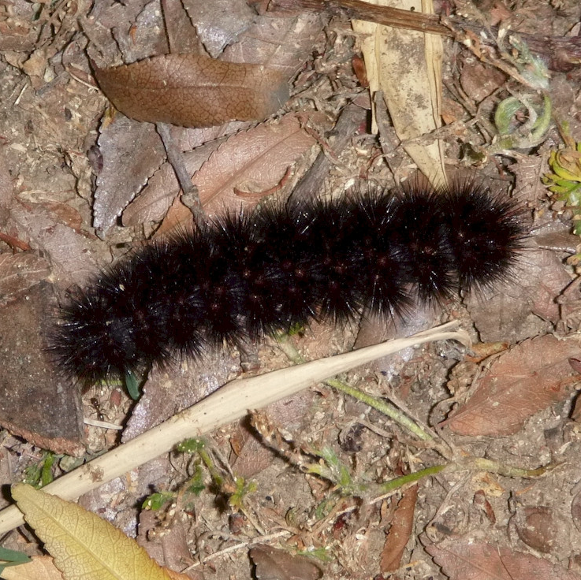
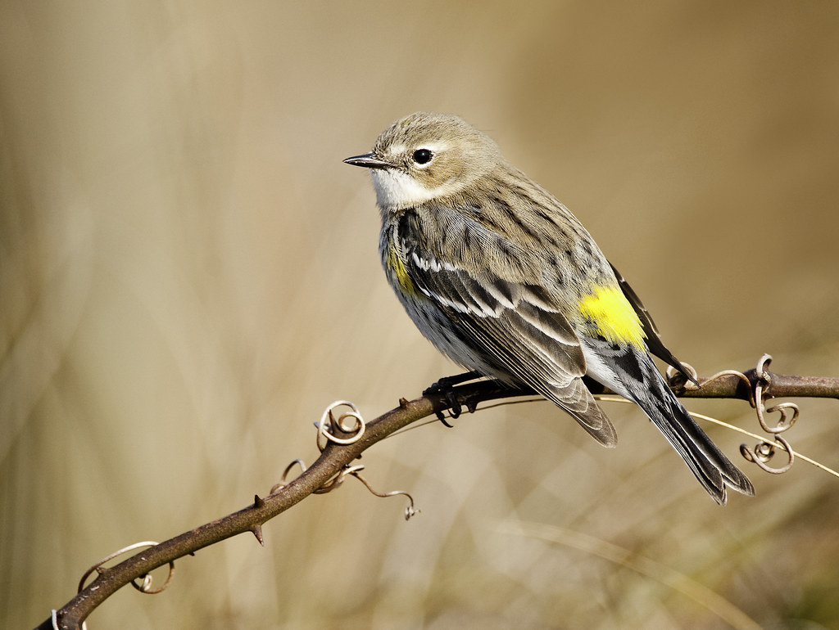
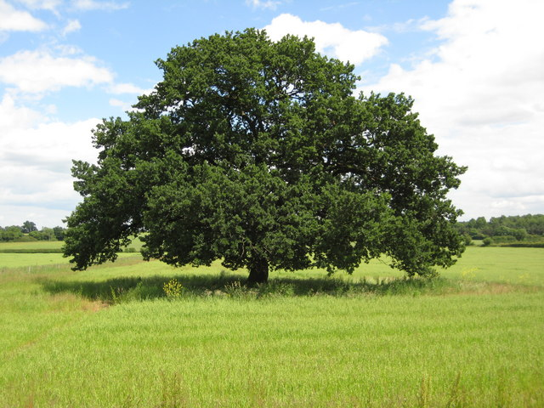


3-Level Food Chain: Producers: Oak trees Primary Consumers: Caterpillars (herbivores) Secondary Consumers: Warblers (insectivorous birds)
This Photo by Unknown Author is licensed under CC BY-SA
This Photo by Unknown Author is licensed under CC BY-SA

Slide 11
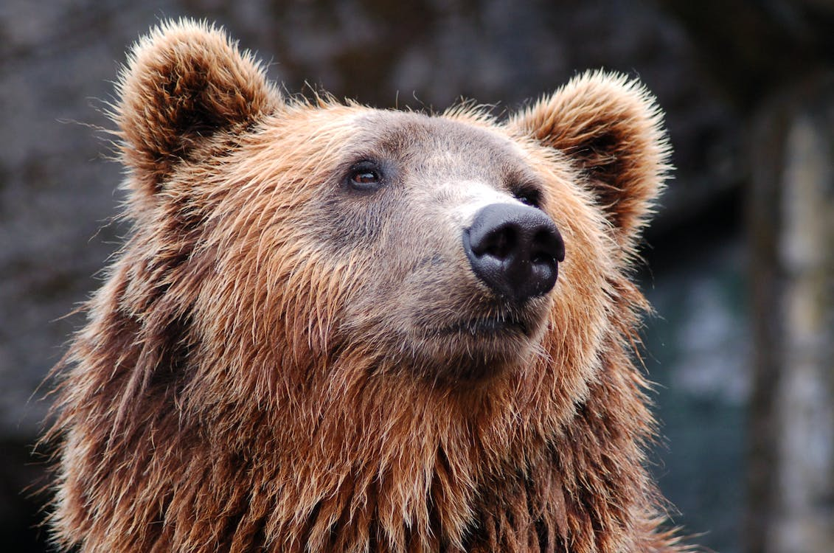
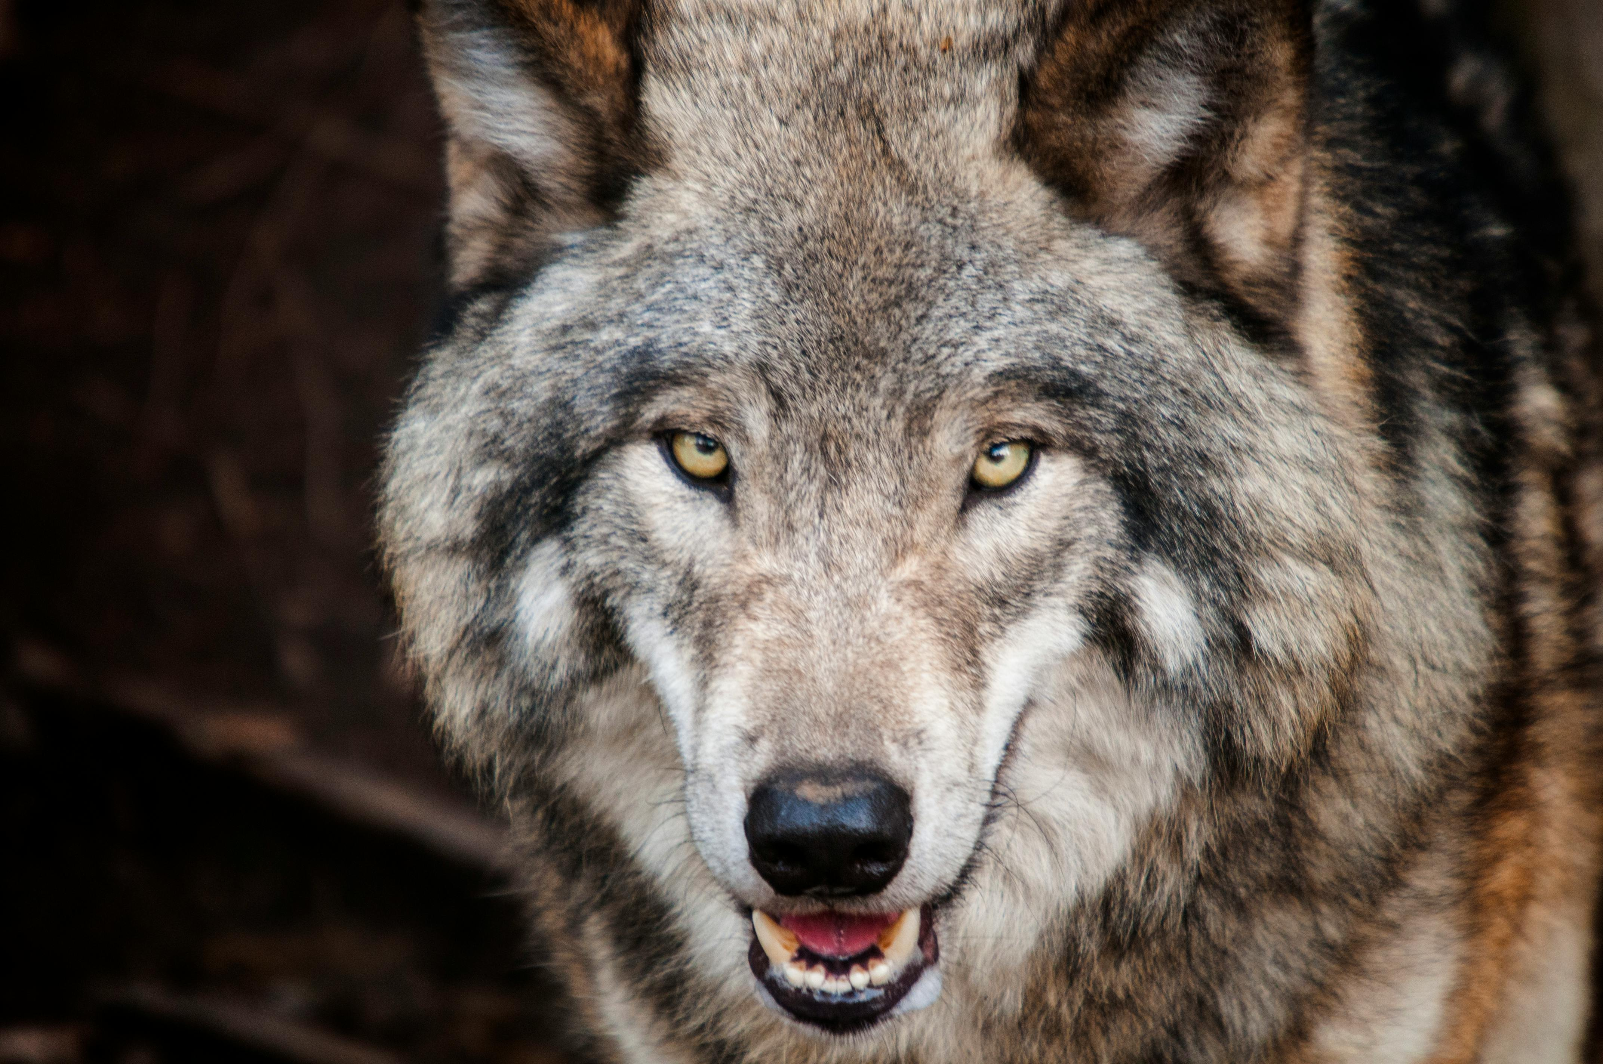
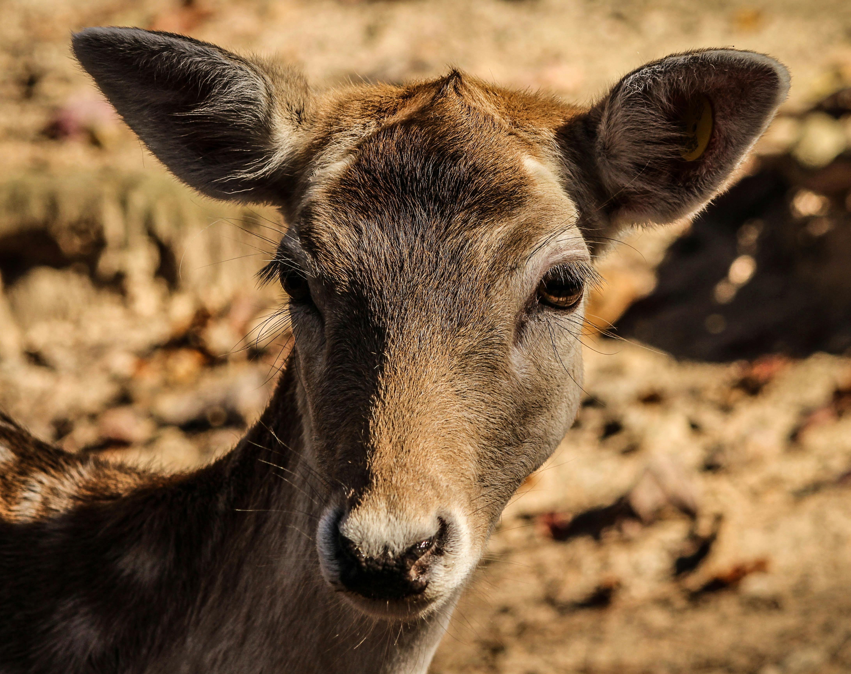



4-Level Food Chain: Producers: Shrubs Primary Consumers: Deer (herbivores) Secondary Consumers: Wolves (carnivores) Tertiary Consumers: Bears (omnivores)

Slide 12
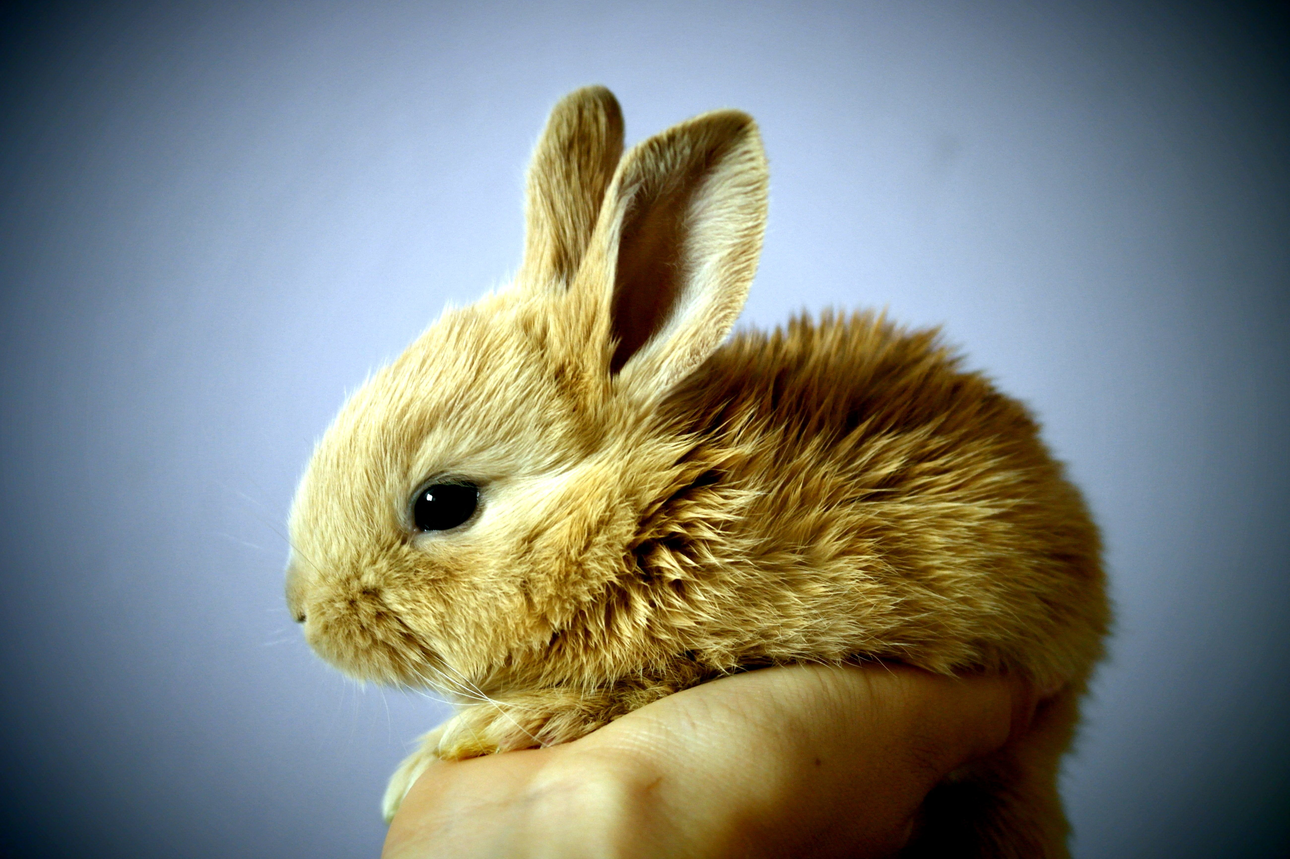
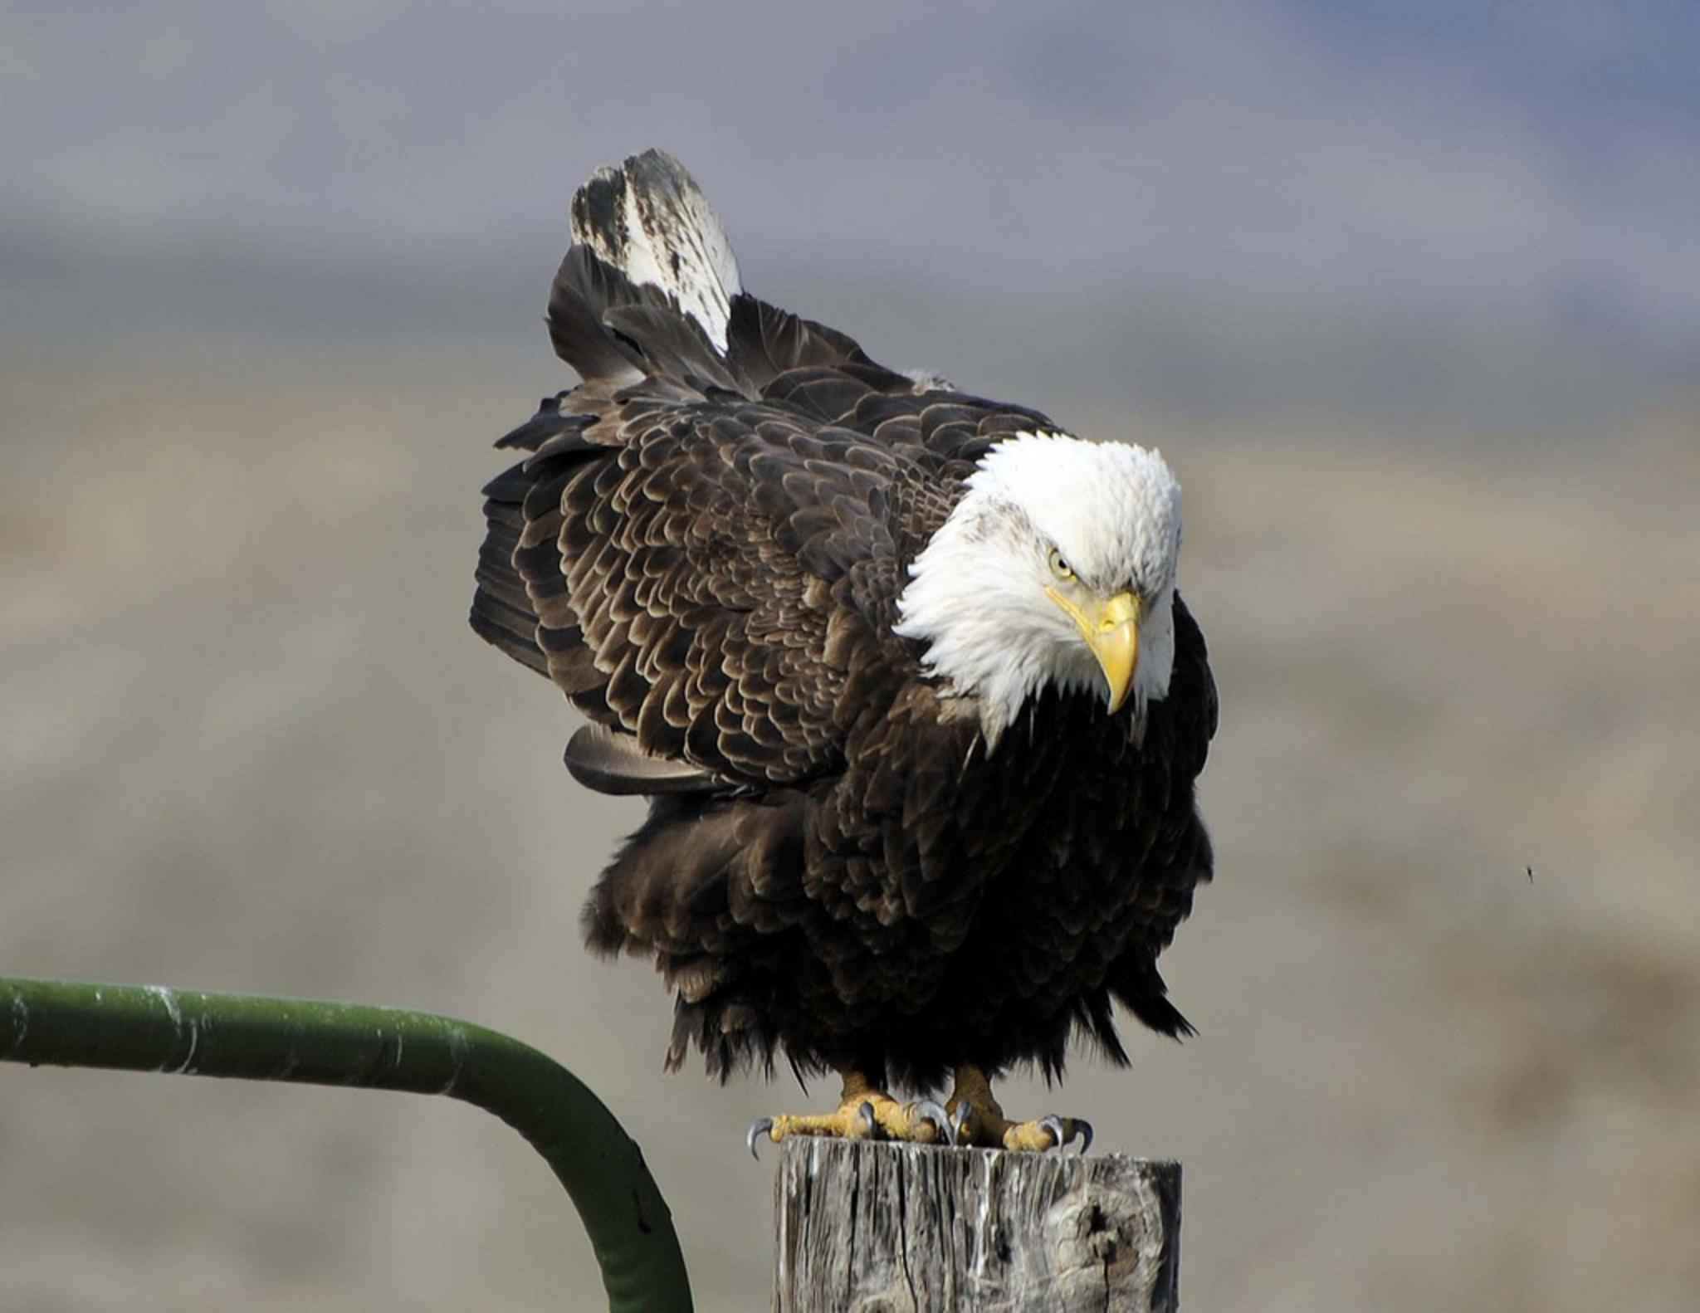
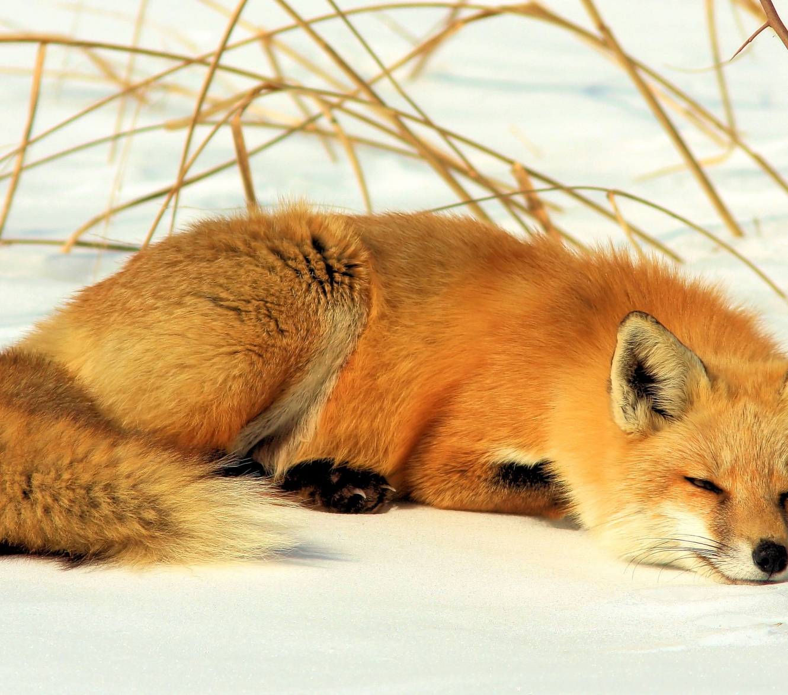
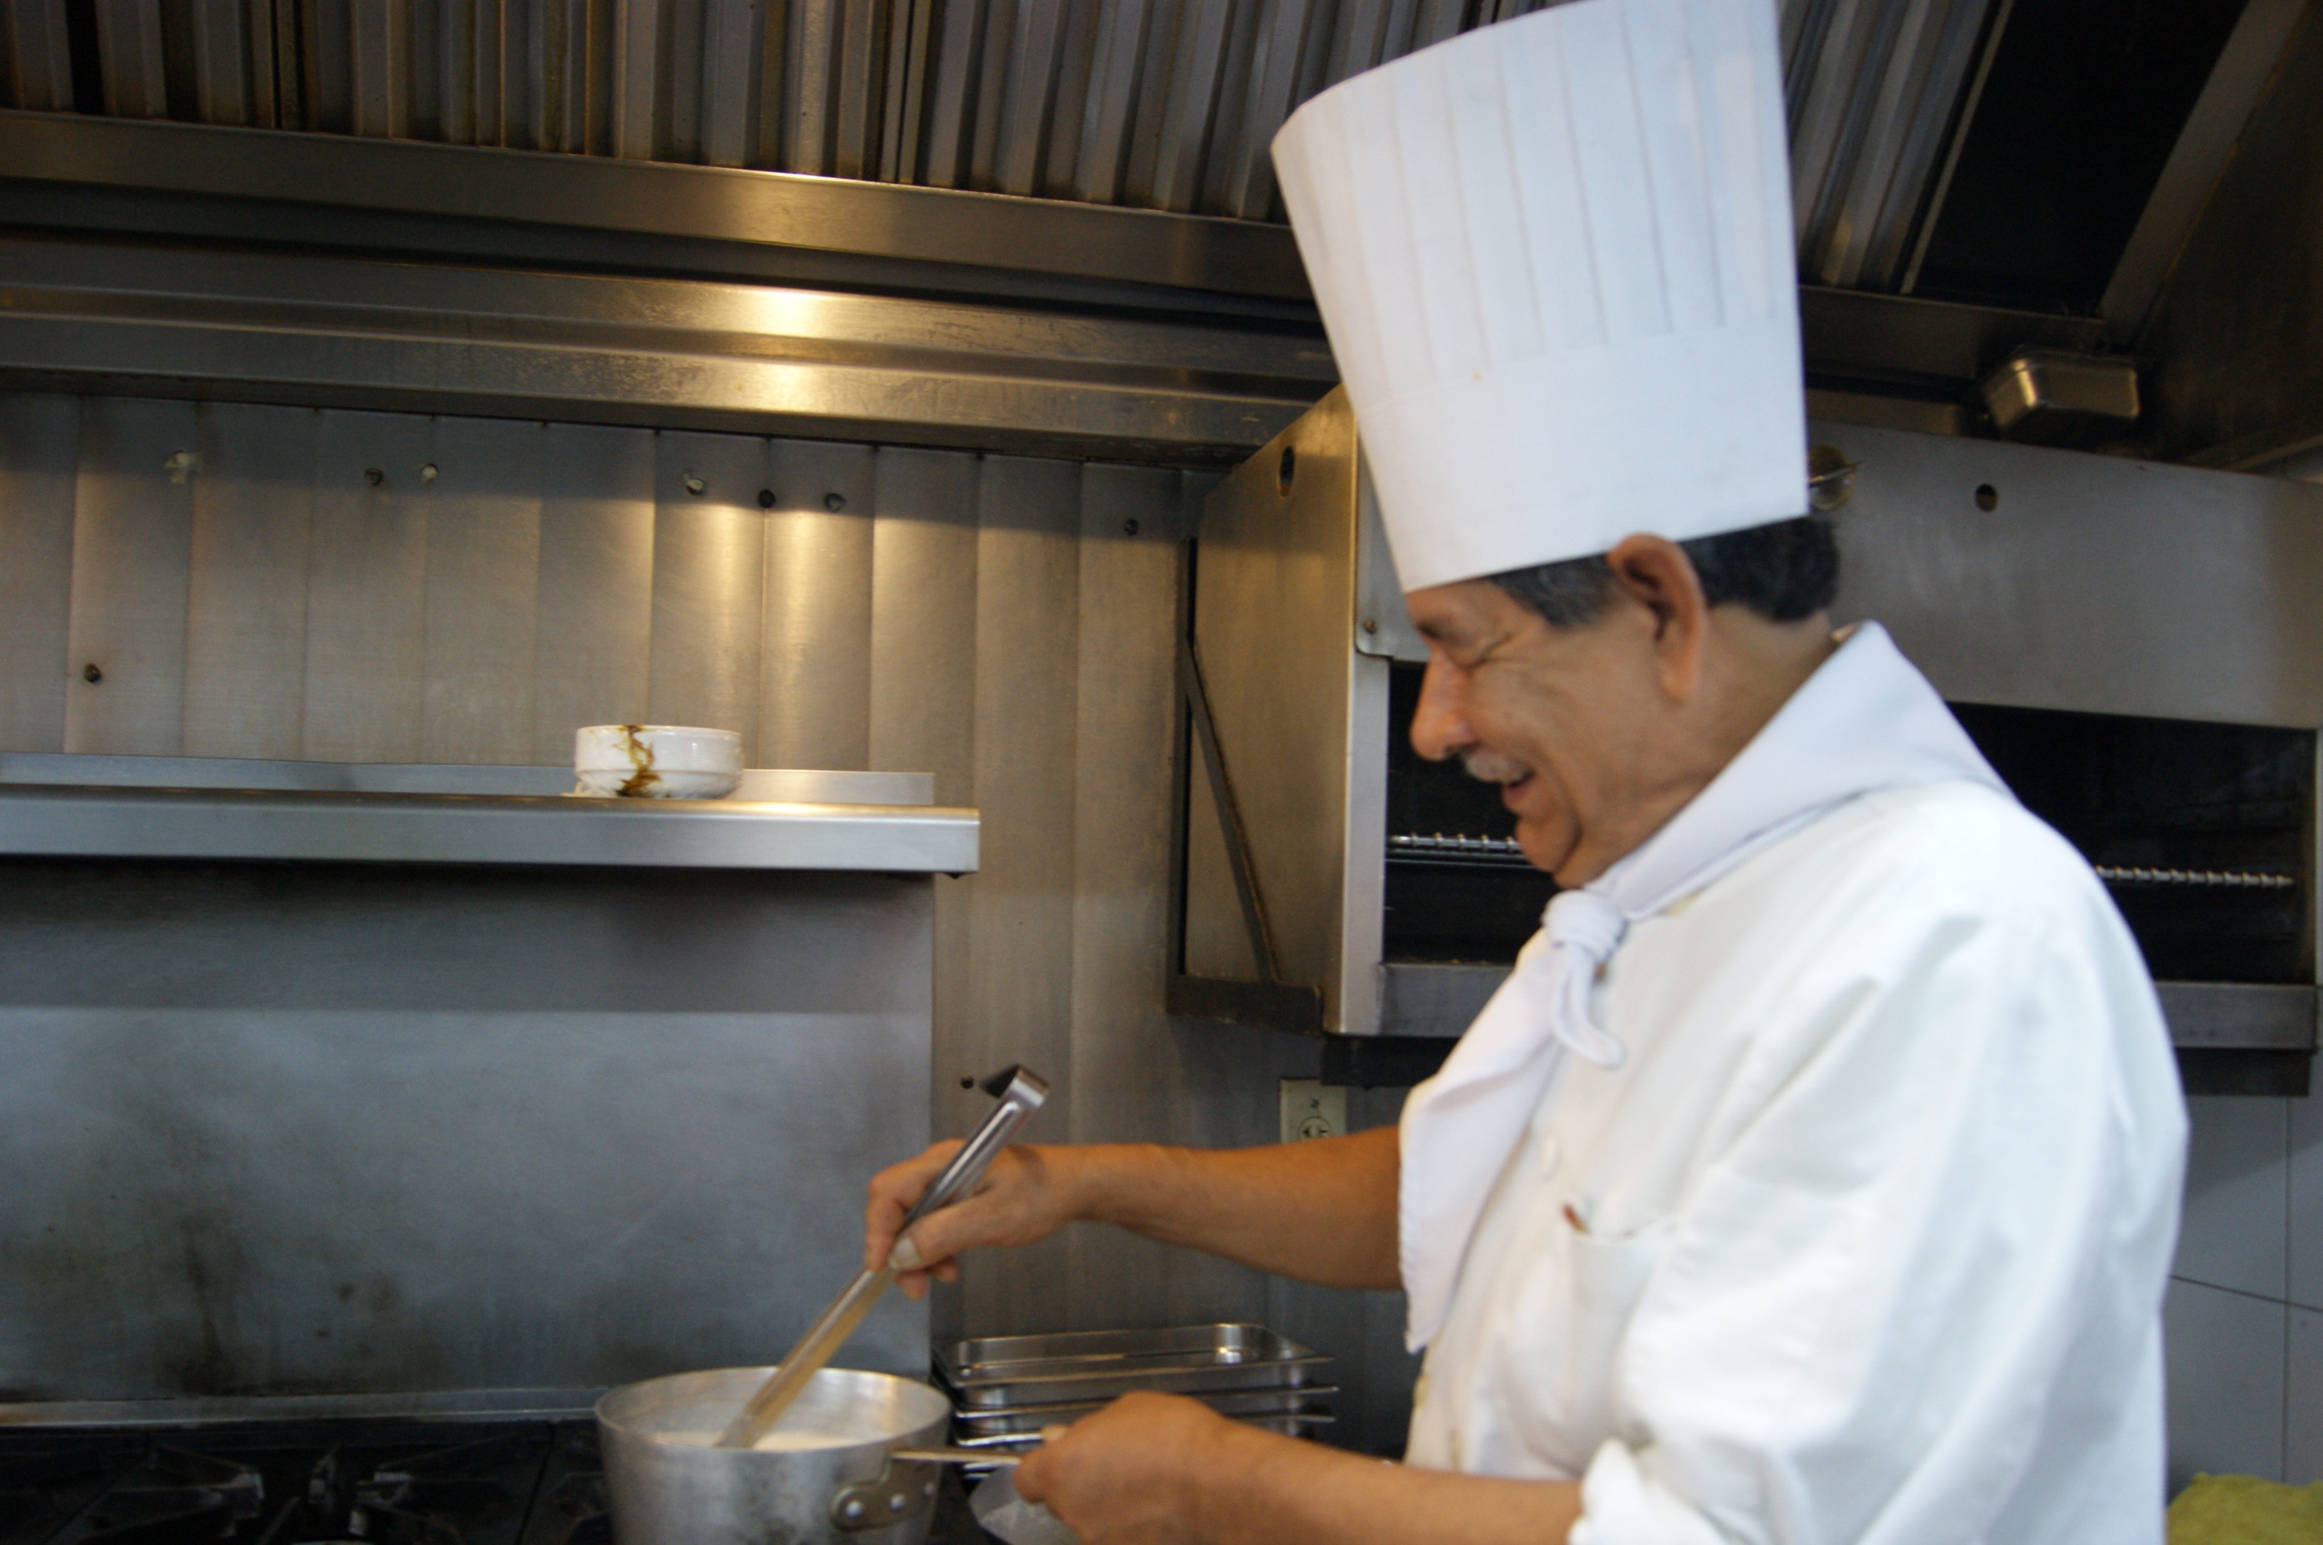






5-Level Food Chain: Producers: Grasses Primary Consumers: Rabbits (herbivores) Secondary Consumers: Foxes (carnivores) Tertiary Consumers: Eagles (carnivores) Quaternary Consumers: Humans (omnivores)

Slide 13
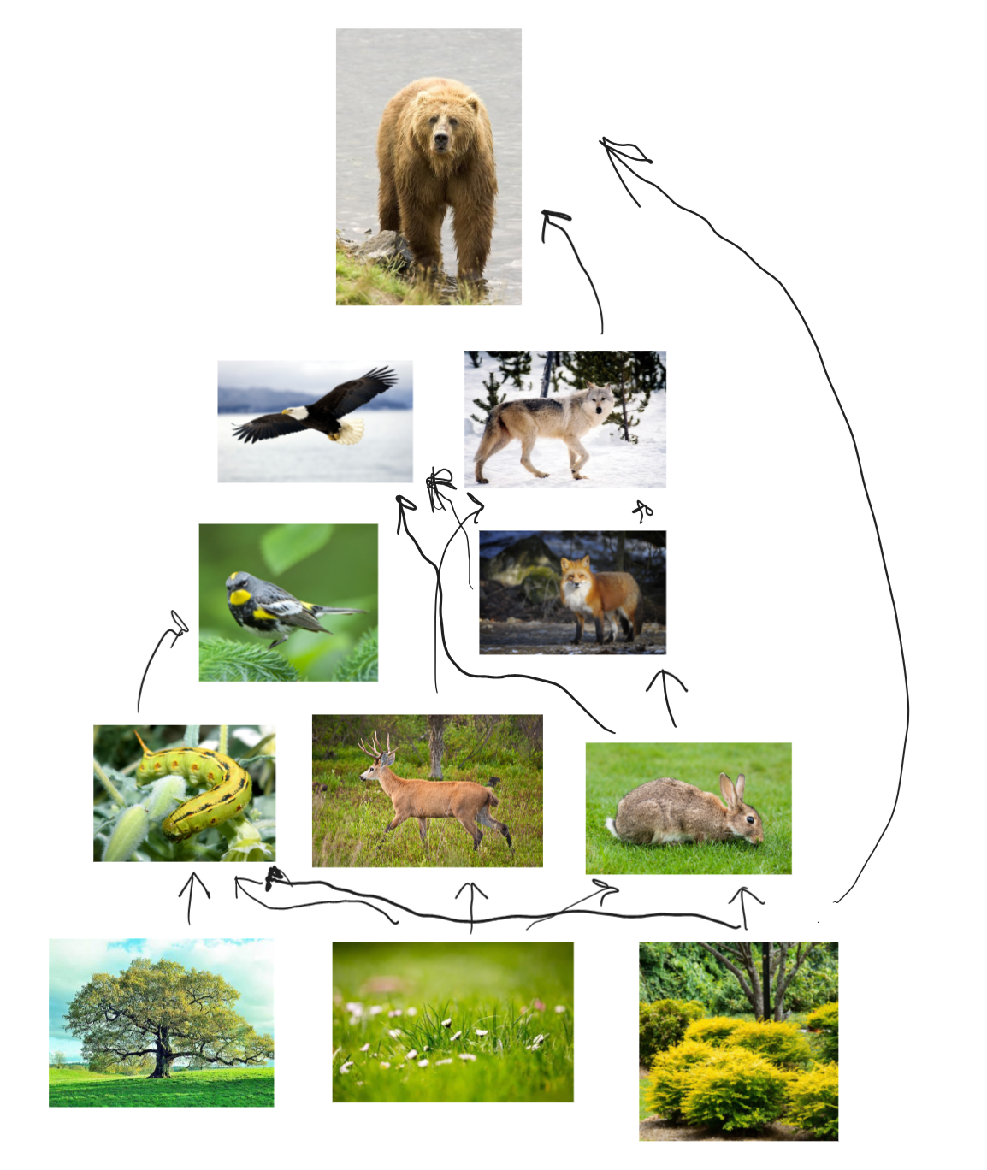

Slide 14
Symbiosis: A close, prolonged association between two or more different biological species
Mutualism:
Both species benefit from the interaction
Commensalism:
One species benefits while the other is neither helped nor harmed
Parasitism:
One species benefits at the expense of the other

Slide 15
Examples
Mutualism
Ants and acacia trees. Ants live in the tree’s thorns and protect it from herbivores, while the tree provides nectar for the ants
Commensalism
Barnacles on whales. Barnacles attach to the whale, gaining mobility and access to more food, while the whale is not harmed or helped
Parasitism
Ticks on mammals. Ticks feed on the mammal’s blood, benefiting at the mammal’s expense

